Slide 1
CPE/AAI/EE 551-A Programming in Python Spring 2022
Tools and Assignments 01/21/2022

Slide 2
Lecture Outline:
Github Account
Install Python
IDLE
Anaconda Navigator
PyCharm
Assignments

Slide 3
Github Account
GitHub is a collaboration platform built on top of a distributed version control system called Git. One does not have to worry about losing data on his hard drive or managing a project across multiple computers - one can sync from anywhere. You can track issues, build & test the things and finally deploy.
Why Use of GitHub for Projects?
Version Control (Allows experiments and mistakes without messing up in final product)
Keep your Code in One Place
Great Collaboration Platform
Create Account via https://github.com.
Useful Links:
https://philchodrow.github.io/cos_2017/1_terminal_and_git/Introduction%20to%20terminal.pdf
Git essential training course by Kevin Skoglund at https://www.lynda.com
Your Github ID: Add your github ID to Google doc: Link
We will not be able to grade next assignments if you do not complete this step.
Notes:
There will be weekly coding assignments. The students will return assignments via github which will be tested using continuous integration tool Travis-CI.

Slide 4
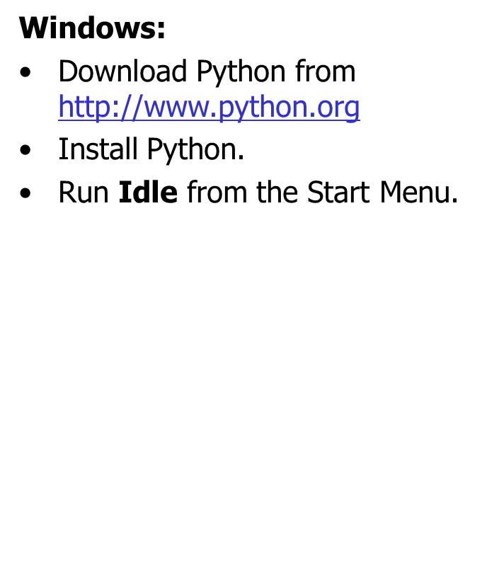
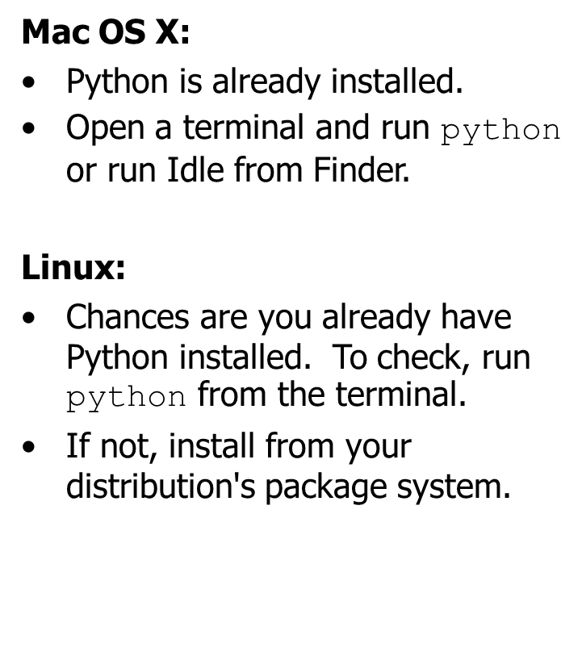
Install Python
IDLE
Make sure to have Python 3.4 or later installed in your system by typing python –V in your shell

Slide 5
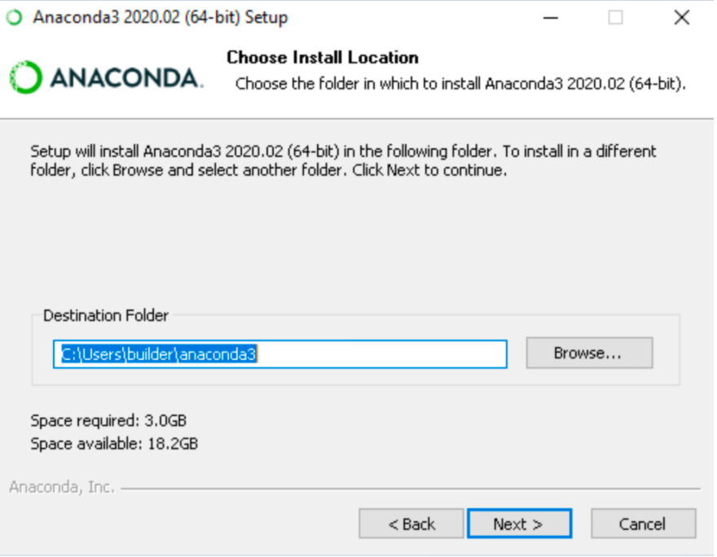
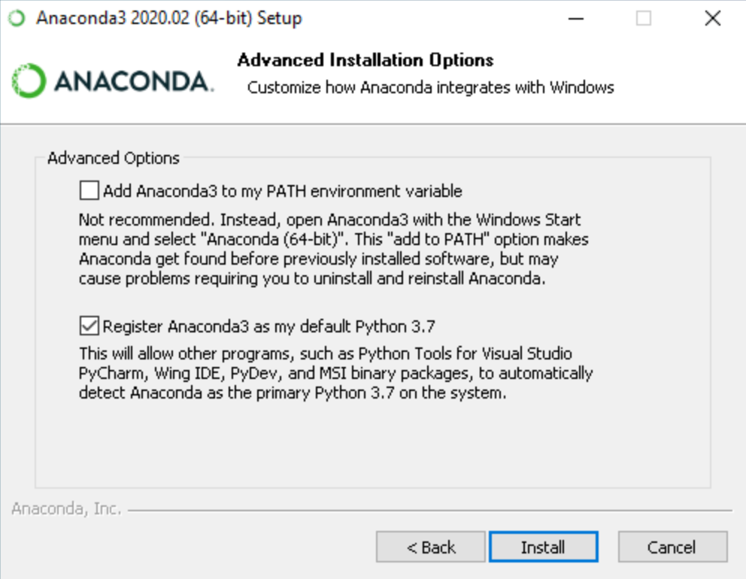
Install Anaconda Navigator
Go to installation documentation: respective to your OS
For Windows, MacOS, Linux
Don’t add the PATH environment variable

Slide 6
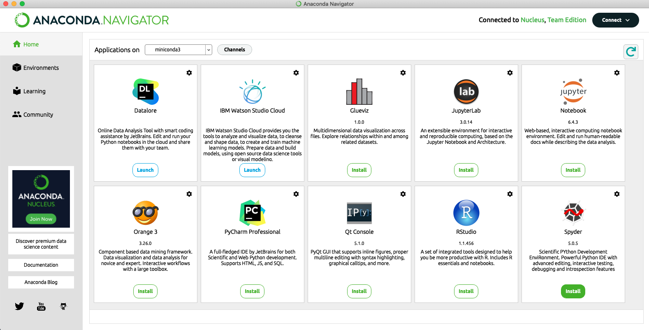
Install Anaconda Navigator
As you can see here you can install PyCharm, Jupyter Notebook, Spyder with only one click.
If you will install software from Anaconda, then you don’t have to worry about the library integration and environments. (Recommended)

Slide 7
Install Pycharm
PyCharm can be installed from Anaconda Navigator as it is shown in previous slide. If you haven’t installed Anaconda Navigator then go through following slides.
PyCharm is available in two versions:
Professional version: It is a full-featured IDE used by professional developers.
Community version: It is an open-source and free software that is not full-featured. You can use it for learning Python application development.
The Professional version is a paid tool and comes with a free trial. You have to buy a license key for it after your free trial period is over.
The Community version, on the other hand, is open-source without any subscription charge.

Slide 8
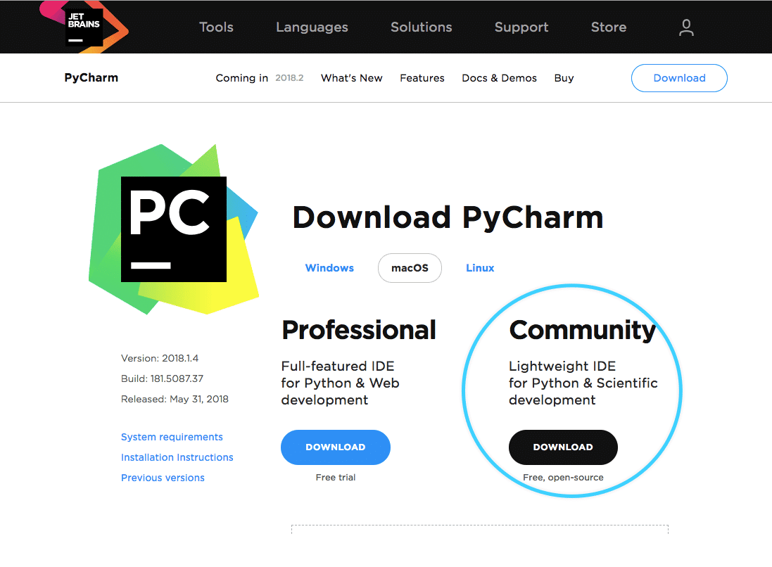
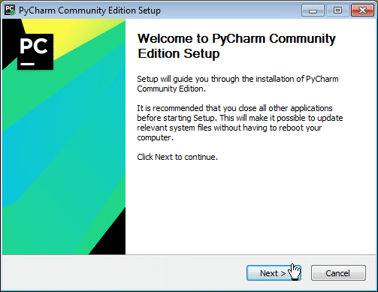
Install Pycharm
Step 1: To download PyCharm, visit the official website of JetBrains: Download PyCharm
Step 2: Click on the ‘Download’’ button
Step 3: After that, you will see the below window with two options, Professional and Community
Step 4: Download the Community version
Note: If you are interested to work with the Professional version, then you can download the Professional version and avail a free trial.
Step 5: After downloading the file, click on it
Step 6: When the following window appears, click on Next and the installation process will start

Slide 9
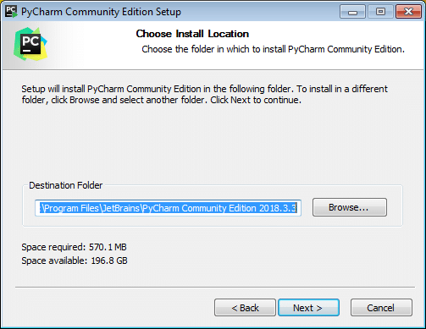
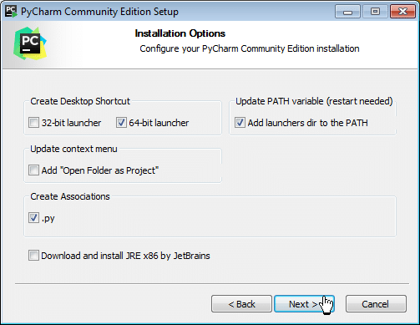
Install Pycharm
Step 7: After clicking on Next, first, a window for setting up the installation location will appear.
Note: You can either select a folder for the installation location or retain the default path.
Step 8: In the next step, you can set the Installation Options as per requirements, and then, click on the Next button to proceed

Slide 10
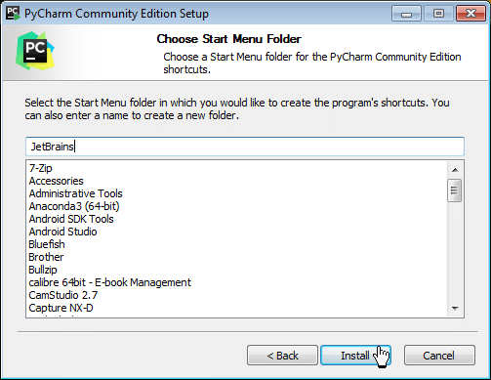
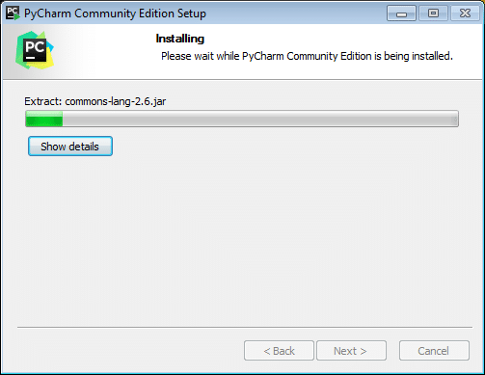
Install Pycharm
Step 9: Now, you have to select the Start Menu folder, or you can leave it as default
Step 10: After these steps, click on the Install button as above to start the installation process

Slide 11
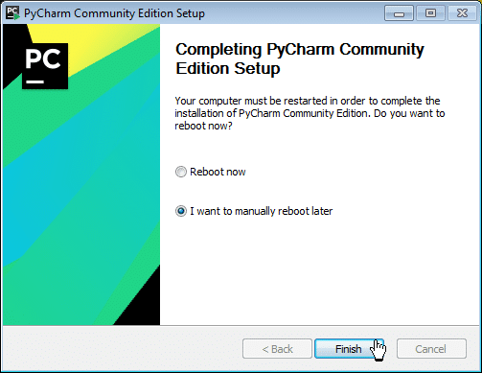
Install Pycharm
Step 11: When you click on the Finish button, your PyCharm installation completes

Slide 12
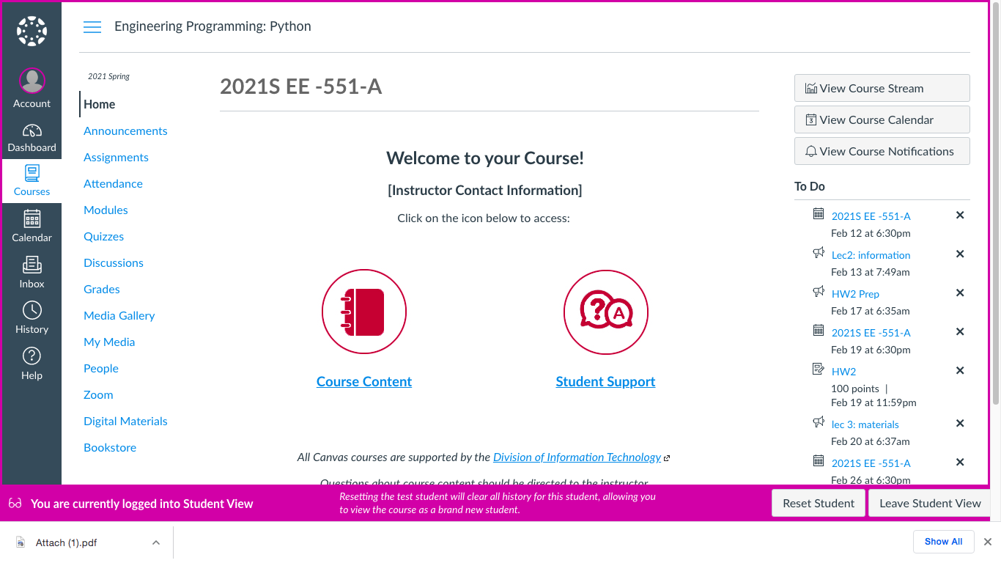
Assignments:
Assignment submission steps:
1st step: Go to Canvas Assignments

Slide 13
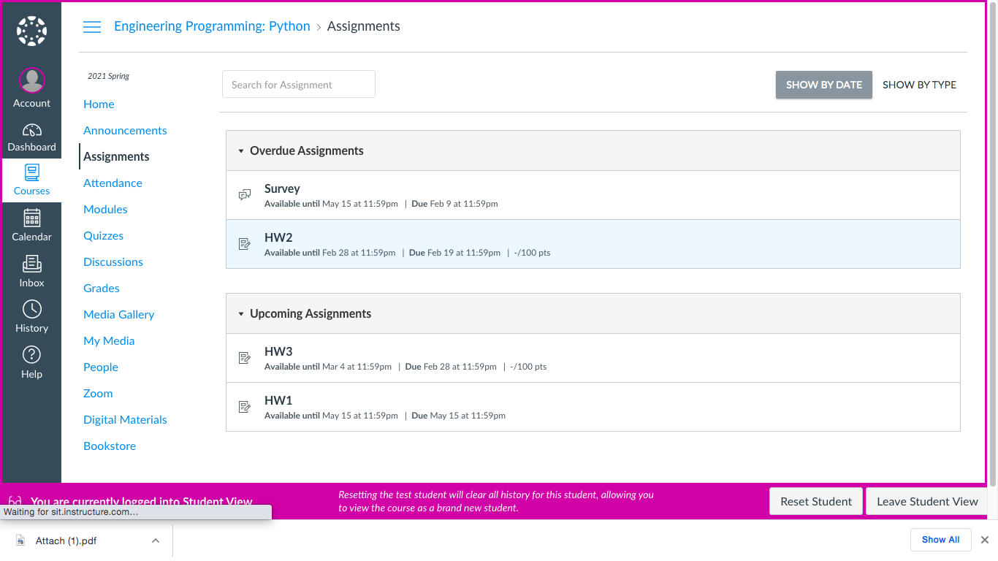
Assignments:
Assignment submission steps:
2nd step: Click assigned HW

Slide 14
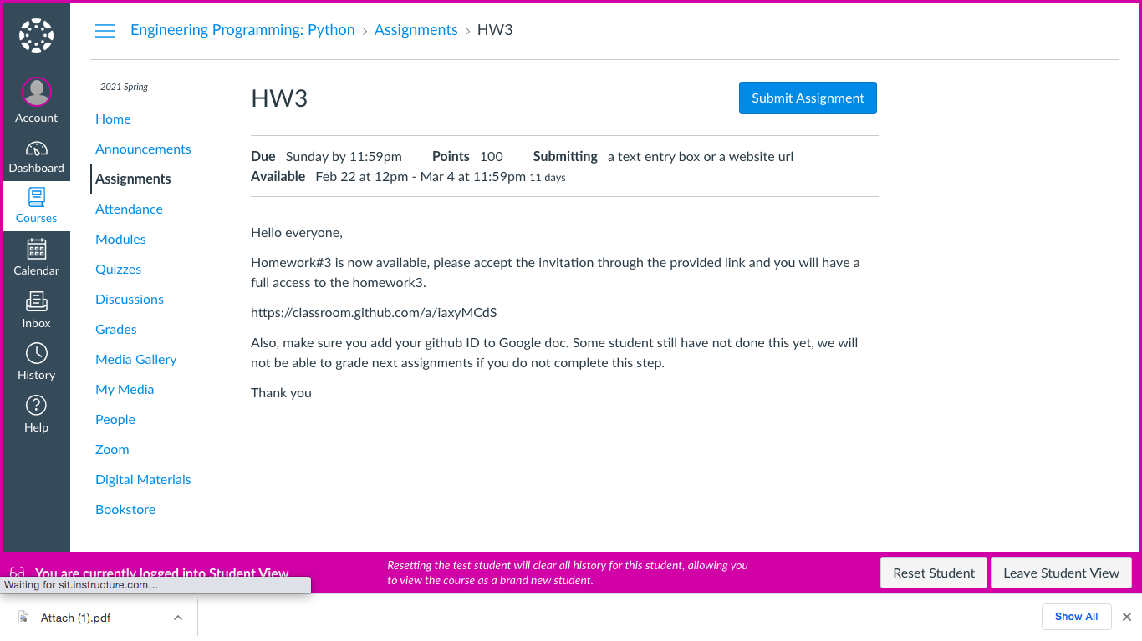
Assignments:
Assignment submission steps:
3rd step: Copy provided link

Slide 15
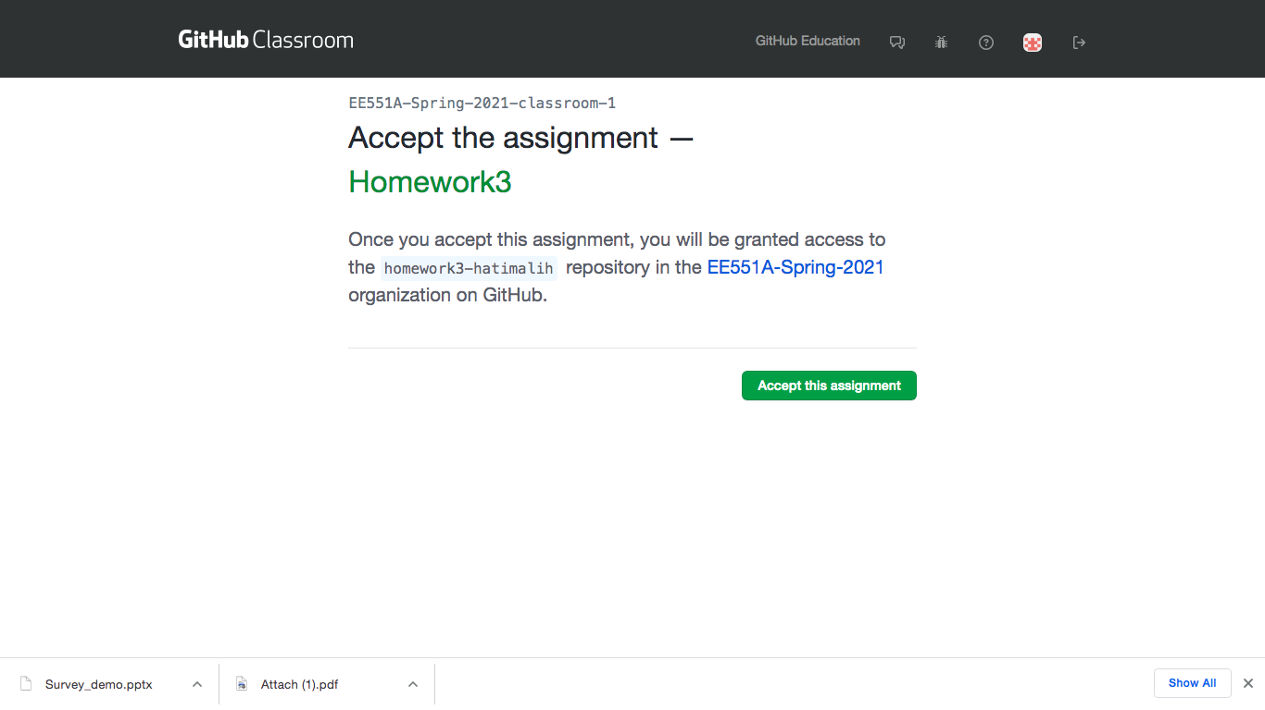
Assignments:
Assignment submission steps:
4th step: accept the assignment

Slide 16
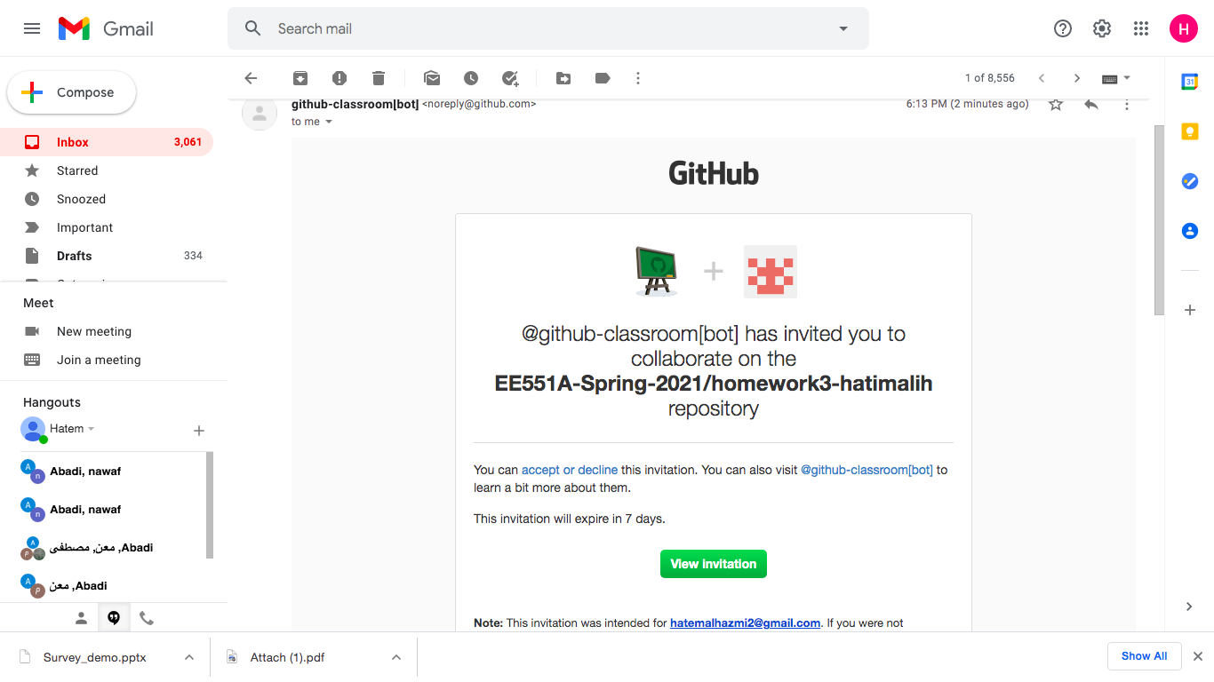
Assignments:
Assignment submission steps:
5th step: You will receive email invitation click View invitation

Slide 17
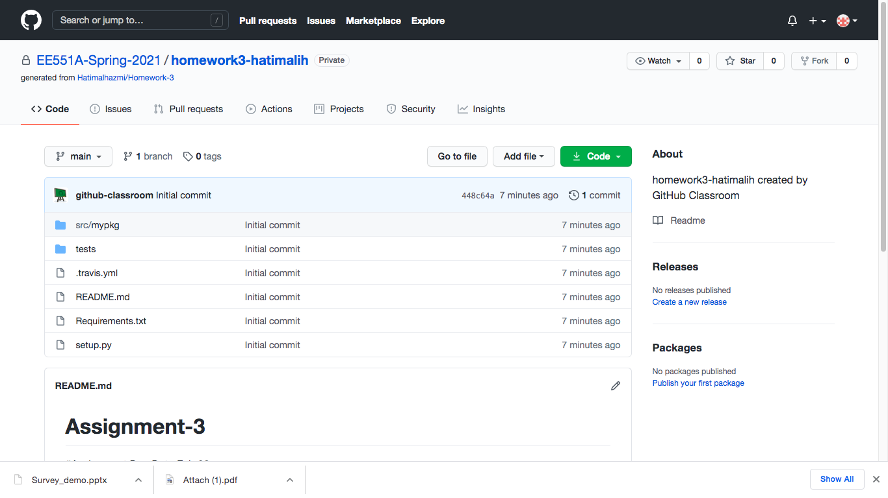
Assignments:
Assignment submission steps:
6th step: After you click view invitation, you now have a full access to the assignment and you have two options:
1st option: download the assignment to your device and use the platform you like to solve the assignment questions provided in my_answers.py and then push your answers back to github.
2nd option go to mypkge and answer the questions directly in my_answer.py “see next slide”

Slide 18
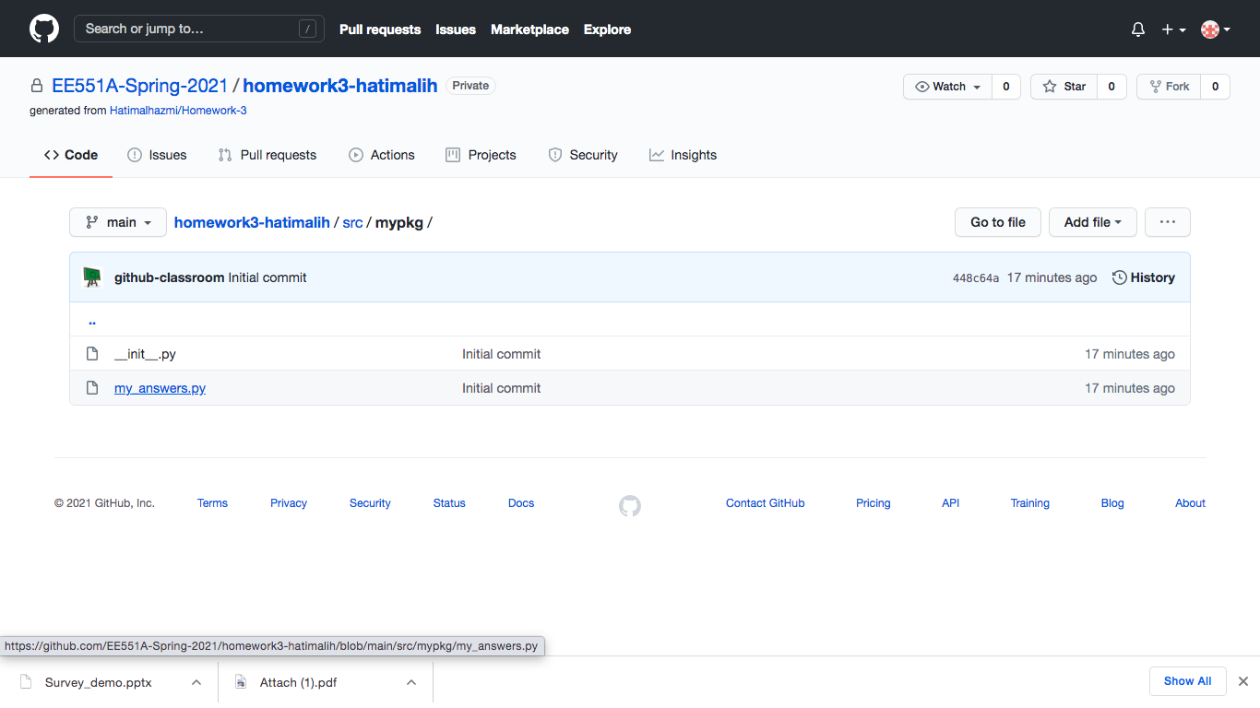
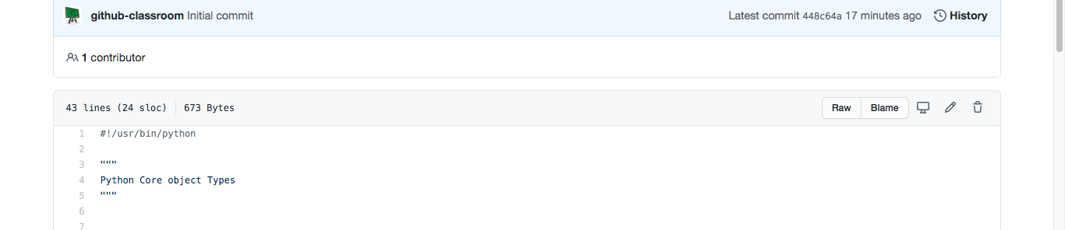
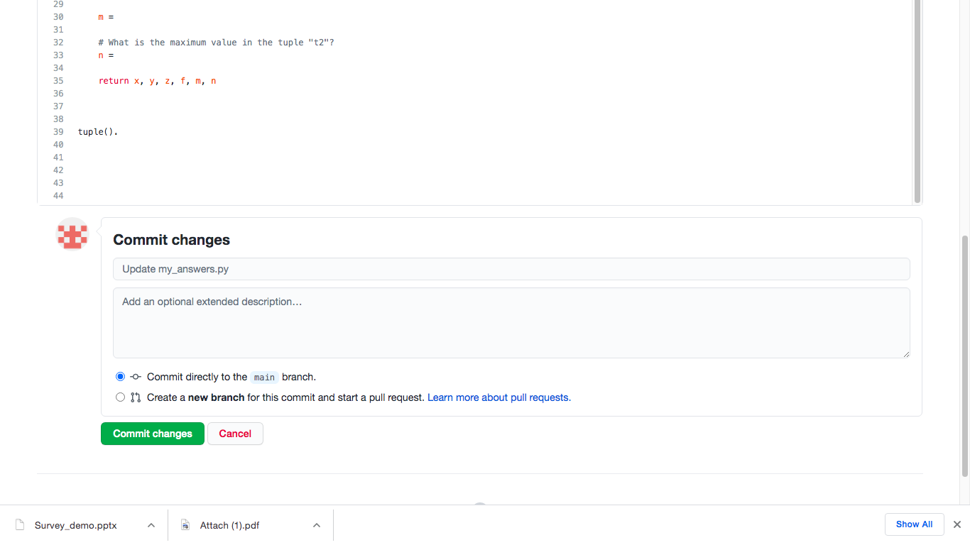
Assignments:
Assignment submission steps:
2nd option con..
if you choice 2nd option: open my_answer.py
Press Edit
answers the Questions then press Commit Change

